Slide 1

AGB1211 – DESIGN THINKING
Department of Artificial Intelligence and Data Science
Academic Year: 2024 – 2025 (Odd Semester)
Year : II
Semester : III
Section : B
Date : 6-12-2024
PRESENTED BY, GUIDED BY
1. JOANY FRANKLIN M.E.,
2. Assistant Professor,
3. Department of AI,
4. K.Ramakrishnan College of Technology.
PRAVEENA V - (2303811724322083) PRAVINA M - (2303811724322084) PRIYADHARSHINI J -(2303811724322085)
RAGHAVI S A - (2303811724322086)

Slide 2

VIRTUAL REALITY BASED EDUCATION PLATFORM

Slide 3

Problem Identification
The integration of virtual reality (VR) into education presents transformative opportunities, but it also comes with distinct challenges.
One significant problem is the accessibility and affordability of VR technology, as high-quality headsets and compatible devices remain cost-prohibitive for many institutions, especially in underserved areas.
Teachers often face a steep learning curve in adopting and effectively using VR tools, which can limit widespread implementation.
Additionally, concerns about prolonged screen time, motion sickness, and potential health effects for students highlight the need for careful consideration of VR’s physiological impact.

Slide 4

Objective
The objective of a virtual reality-based education platform is to revolutionize traditional teaching and learning methods by leveraging the immersive and interactive capabilities of VR technology.
It aims to create engaging and dynamic learning environments that go beyond the limitations of textbooks and traditional classrooms, allowing learners to explore concepts in a hands-on and experiential manner.
By simulating real-world scenarios, historical events, or scientific phenomena, the platform seeks to make abstract ideas tangible and foster a deeper understanding across a wide range of subjects.
Ultimately, the goal is to prepare students for the future by enhancing their skills and knowledge through innovative, technology-driven education.

Slide 5
Brain Storming
360 DEGREE VIDEOS
GAMING EDUCATION
3D SIMULATION
TEACHER TOOLS
EDUCATIONAL TECHNOLOGY
REAL-TIME FEEDBACK
VIRTUAL LABS
STUDENT ENGAGEMENT

Slide 6
Brain Storming
EXPERIMENTAL LEARNING
DIGITAL CLASSROOMS
DISTANCE EDUCTION
LANGUAGE LEARNING
LIFELONG LEARNING
CONTENT CREATION
SOFT SKILL DEVELOPMENT
LEARNING ANALYSIS

Slide 7


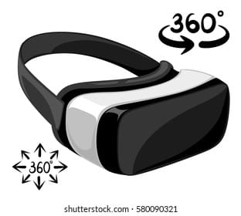


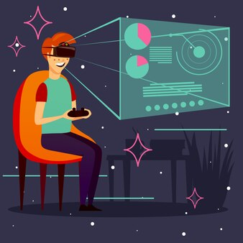
Mind Map
VIRTUAL LABS
STEM EDUCATION
DIGITAL CLASSES
SOFT SKILLS
FEEDBACKS
EXPERIMENTAL
LEARNING ENGAGEMENT
EDUCATIONAL STRATEGIES
VIRUTAL REALITY BASED EDUCATION PLAFORM
IMMERSIVE TECHNOLOGY
CONTENT & TOOLS
VIRTUAL REALITY
VR COURSES
3D SIMULATIONS
VR TRAINING
360° VIDEOS
VR TUTORING

Slide 8
Primary Research
Surveys and Questionnaires: Collecting data from students, educators, and administrators to assess interest, challenges, and expectations regarding VR in education.
Interviews: Conducting in-depth interviews with stakeholders, such as teachers, curriculum designers, and technology providers, to gain insights into needs and preferences.
Focus Groups: Engaging groups of students and educators to explore potential use cases, usability, and the effectiveness of VR applications in real-world learning scenarios.
Pilot Studies: Running small-scale experiments or trial programs to test the impact of VR on specific educational goals, such as engagement or retention rates.
Observations: Directly observing the use of existing VR solutions in educational settings to identify gaps, user behaviors, and areas for improvement.

Slide 9
Secondary Research
Exploring Industry Reports: Examining market research reports, white papers, and analyses from technology and education sectors to identify trends, market size, and future potential of VR in education.
Studying Competitor Platforms: Investigating existing VR education platforms to understand their features, target audience, pricing models, and user feedback.
Analyzing Online Content: Reading blogs, forums, and articles to gather opinions, success stories, and critiques about VR-based learning.
Reviewing Educational Policies and Frameworks: Examining national and international guidelines, funding opportunities, and strategies for integrating technology, including VR, into education systems.
Data Mining: Analyzing publicly available datasets on technology adoption in education, demographic information, and performance outcomes.

Slide 10
Proposed Work
The proposed work involves designing and implementing a cutting-edge virtual reality-based education platform that revolutionizes traditional learning methods by creating highly immersive and interactive environments.
The platform will cater to a wide range of educational needs, including STEM subjects, humanities, and vocational training, through experiential simulations, virtual laboratories, and scenario-based learning modules.
By collaborating with educators, researchers, and technology experts, the proposed work aspires to create a transformative educational tool that promotes equal opportunities, fosters curiosity, and equips students with skills for the future.

Slide 11
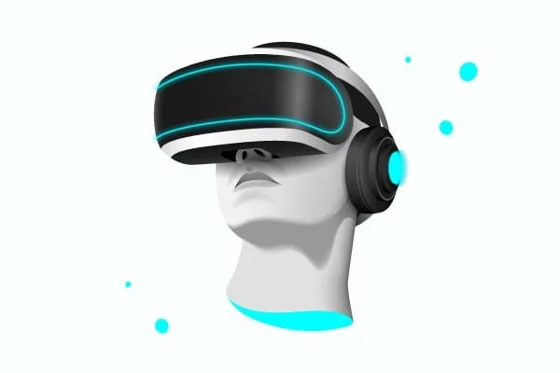

List of Modules
VR Content Library
Collaboration Module
Progress Tracking and Analytics

Slide 12
VR Content Library
The VR Content Library is the heart of the platform, housing all the educational modules and simulations that users interact with.
It includes immersive lessons, virtual labs, interactive simulations, and assessments tailored to various subjects such as science, history, mathematics, and more.
The library offers diverse learning experiences that allow students to explore concepts through 3D environments, enhancing engagement and understanding.
Teachers can access and modify content, while students can navigate through lessons, quizzes, and virtual field trips.

Slide 13
Collaboration Module
The Collaboration Module fosters real-time interaction among users in a virtual space, promoting group learning, peer feedback, and teamwork.
Teachers can monitor student interactions, facilitate group discussions, and guide collaborative projects.
This module helps build communication and teamwork skills, enhancing the learning experience through social engagement.
It also allows users to share their progress and findings with their peers or instructors in an interactive and collaborative way.

Slide 14
Progress Tracking and Analytics
This module is designed to monitor and evaluate student performance and engagement throughout their learning journey.
It tracks metrics such as quiz scores, time spent on tasks, completion rates, and interactions with various VR modules.
Teachers can view individual and class-wide progress reports, helping them identify areas where students are struggling or excelling.
The system uses data analytics to generate actionable insights, allowing for personalized feedback and adaptive learning paths.

Slide 15
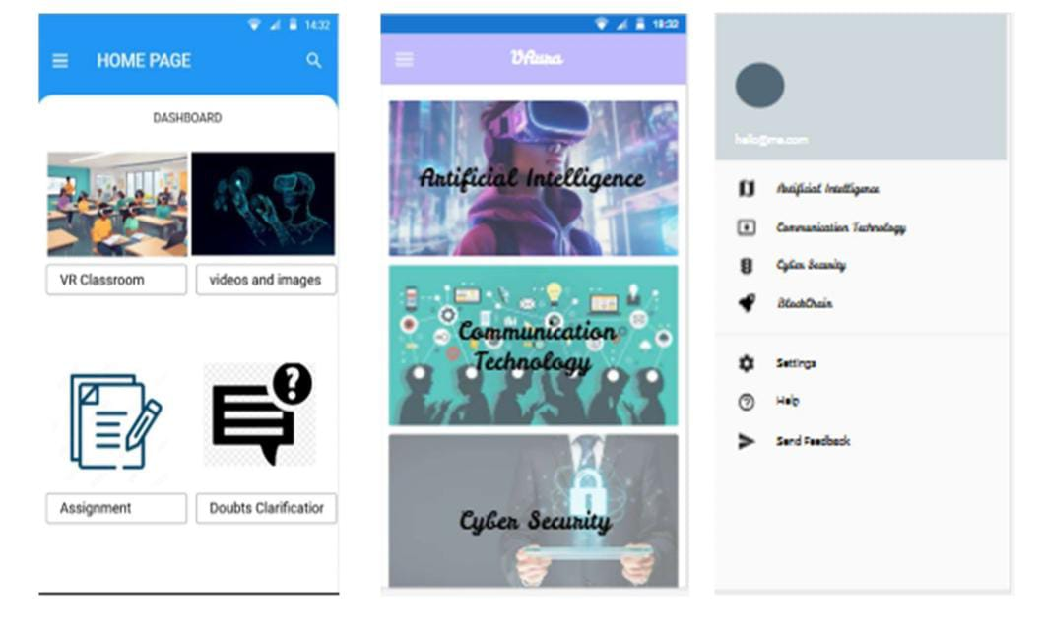
Results
screenshots

Slide 16
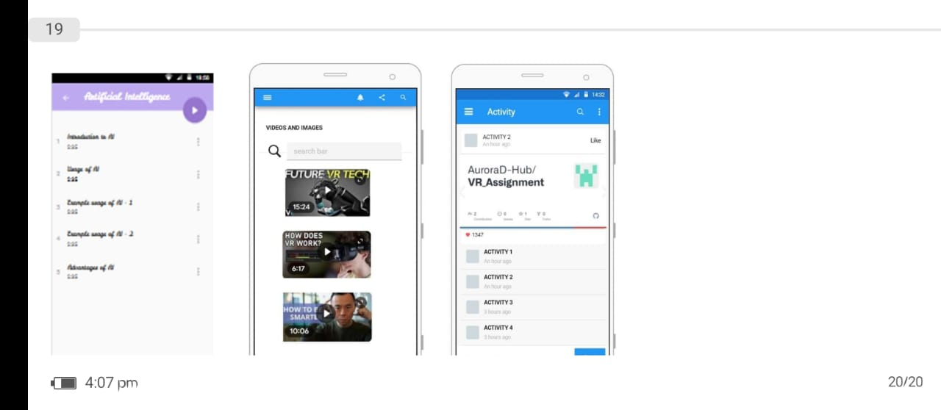
Results
screenshots

Slide 17
Conclusion
The Virtual Reality-Based Education Platform offers a transformative approach to modernizing education by combining immersive technology with innovative learning techniques.
Through key modules such as the VR Content Library, Collaboration Module, and Progress Tracking, the platform enhances engagement, promotes active learning, and fosters collaboration among students and teachers.
The platform’s data-driven approach ensures personalized learning experiences, while its scalable design makes it accessible to a wide range of educational institutions.

Slide 18
Thank You
Any queries???

